Slide 1
WebVR/XR Intro
Timo Kraus, Abdul Wahab, Mohsin Ali, Hurair Hashmi

Slide 2
Agenda
WebVR/XR Overview
The immersive web community at W3C
Our Project Idea

Slide 3
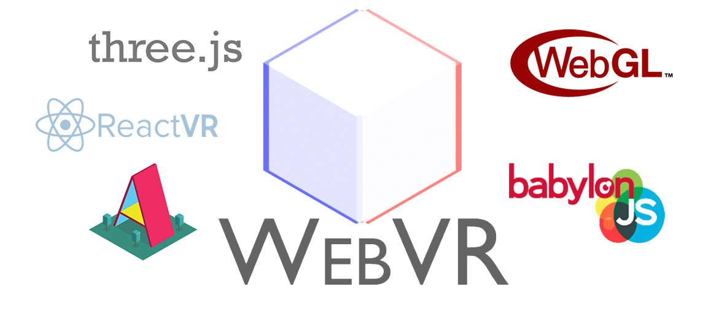
Overview

Slide 4
Overview
WebVR: The API
A under-development browser interface to interact with hardware
Abstract out the types of VR devices to be handled by the browser so developers can focus on content, not supporting specific devices
The VR Web
Build out experiences for virtual reality on the internet
Include VR-enabled content into the web as it exists today

Slide 5
Benefits of WebVR
No installation of application is needed – run in the browser on any device
Automatically support mobile and desktop devices
Utilize the current set of tools and libraries for JavaScript
Easily switch between VR and non-VR mode
Offload interfacing with hardware to the browser

Slide 6
How it works
Desktop VR
Web page is rendered without VR support
Browser detects that there is a VR device attached to the computer and stores the information about it
Web page is put into VR mode by the user and the site queries the browser for information about the device
This information is then applied to render the page stereoscopically
Mobile VR
Web page is rendered without VR support
Browser detects that the device is a phone
Web page is put into VR mode by the user and special code included in the website creates a stereoscopic rendering by querying the device size and splitting down the middle
The phone gyroscope updates orientation, view and position of the camera

Slide 7
What’s in a VR App?
Scene: Environment rendered through WebGL
VRControls: Listen for hardware position changes and use them to manipulate the camera within the scene
VRManager: Query for devices and apply hardware
VREffect / VR-Polyfill: Render your scene with two side by side cameras

Slide 8
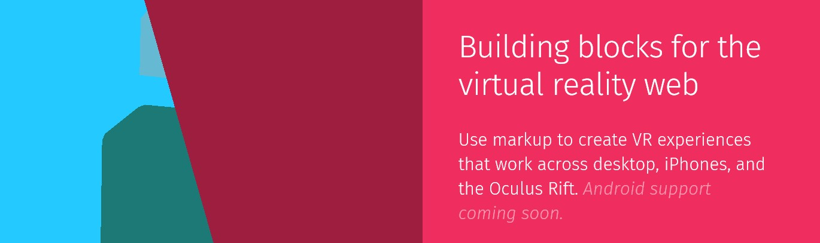

Looking Ahead - A-Frame
A-Frame is a new project for integrating virtual reality content directly into markup on a webpage

Slide 9
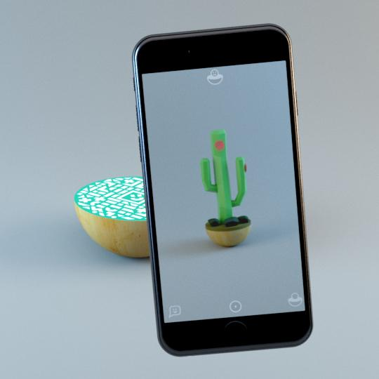
Looking Ahead - WebXR
Mixed Reality is going to be a powerful platform, bringing highly engaging and emotionally evocative immersive content to the web.
Experimentation continues with a new JavaScript API called the WebXR Device API. This specification will replace WebVR in time and offer a smooth path forward.

Slide 10
What’s new in WebXR?
The new WebXR Device API has two new goals that differentiate it from WebVR. They are:
To support a wider variety of user inputs, such as voice and gestures, giving users options for navigating and interacting in virtual spaces
To establish a technical foundation for development of AR experiences, letting creators integrate real-world media with contextual overlays that elevate the experience.

Slide 11

W3C Immersive Web Community
W3C Community and Business Groups give developers, designers, and anyone passionate about the Web a place to hold discussions and publish ideas. These groups are proposed and run by the community.
Goal is to help bring high-performance Virtual Reality to the open Web
Most of the group’s activity is happening in the WebXR Github Repository
https://www.w3.org/community/immersive-web/

Slide 12
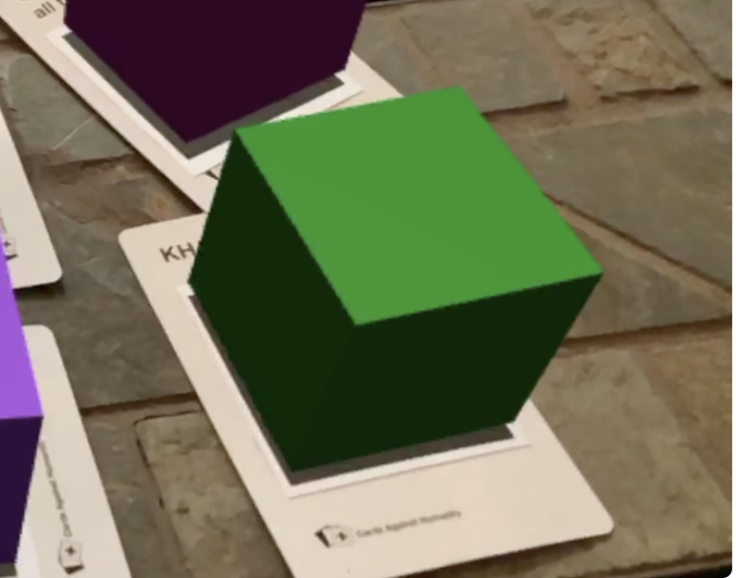
Our Project
Creating a easy to adapt blueprint for AR apps
Show any 3D object in on markers in Augmented Reality App
Offer a way to manage content / change 3D objects
Example implementation for one use-case (tbd)
We will develop the product in an agile way (Kanban)

Slide 13
Our Project
Can later be used for any AR use-case you can imagine, e.g:
Education
Tourism
E-Commerce
Commercials
Automobile Industry
...

Slide 14
Milestones
Project is planned in small deliverables as follows:
Research (Reading Papers/Publications) (approx. 2 weeks)
Developing a prototype (Until Second Presentation) (approx. 5 weeks)
Functioning Application & Documentation (Final Presentation) (approx. 5 weeks)

